Slide 1
Electric Vehicle Analysis
FY 2022 – FY 2024

Slide 2
Outlines of Presentation
Insights from the data from FY 2022 to FY 2024
Reasons for choosing EV vehicles
Impact of Incentives
Charging Infrastructure Correlation
Ideal Manufacturing Location
Top Recommendations

Slide 3
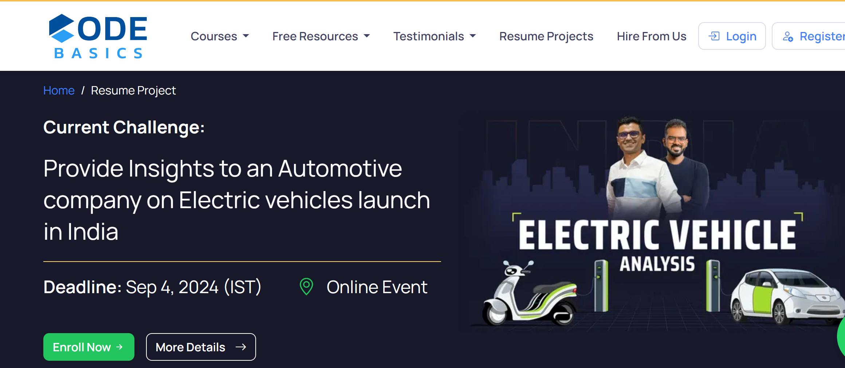

Slide 4
Data Insights from FY 2022 to FY 2024

Slide 5
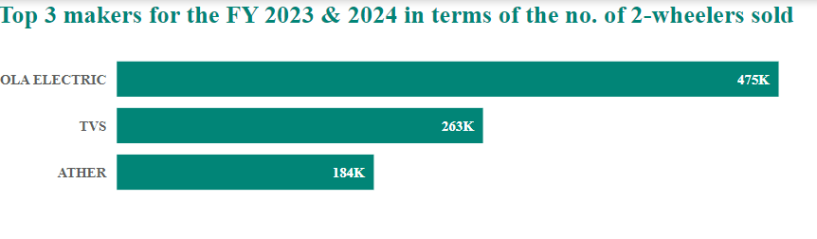
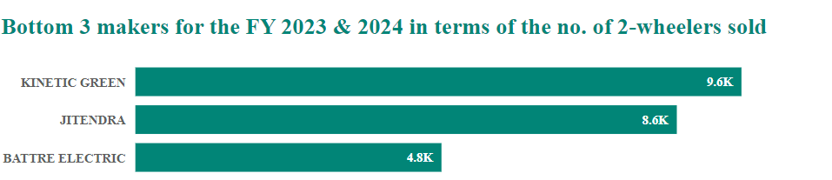
The performance of 2-wheeler makers in terms of the number of units sold during the fiscal years 2023 and 2024.

Slide 6
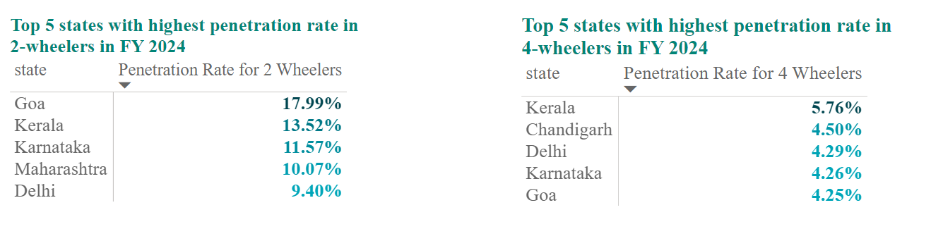
In FY 2024, Goa achieved the highest penetration rate (17.99%) for 2-wheelers, while Kerala led in penetration rate (5.76%) for 4-wheelers.

Slide 7
States that experienced a decline in EV sales penetration from FY 2022 to FY 2024:
The Andaman and Nicobar Islands saw a decline in 4-wheeler EV sales penetration, with a decrease of 1.11%.
Ladakh experienced a slight decline in 2-wheeler EV sales penetration, with a decrease of 0.41%.

Slide 8
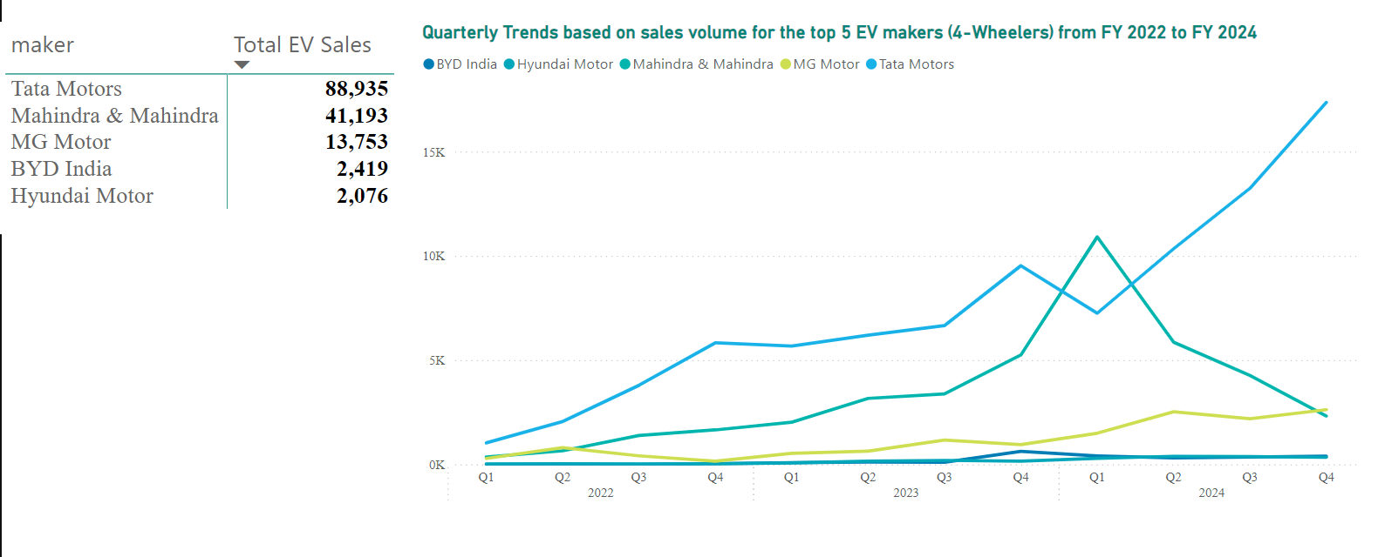
Top 5 EV makers sales volume (4-wheelers) from FY 2022 to FY 2024 and their quarterly trends

Slide 9
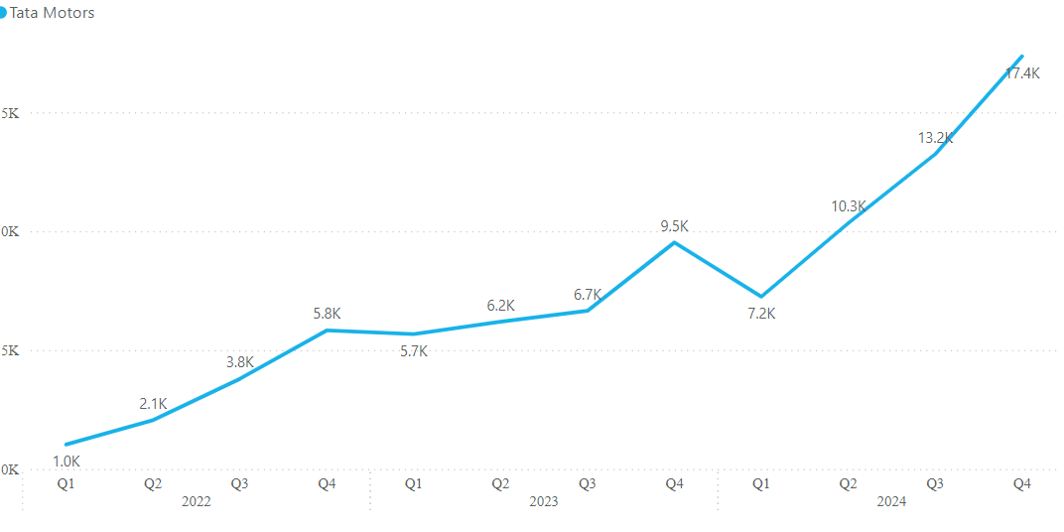
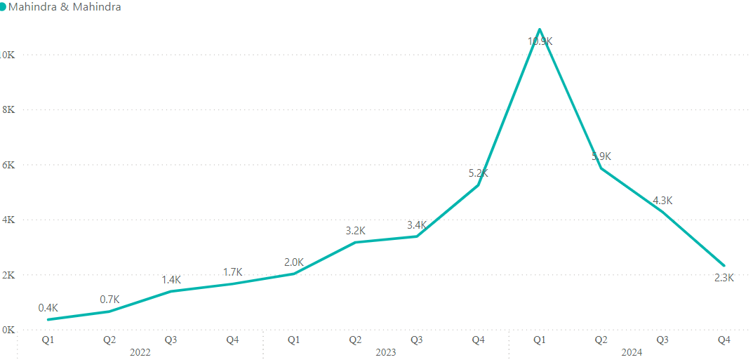
Tata Motors experienced gradual growth in sales volume, reaching a peak of 9.5K units in Q4 FY 2023. After a slight dip in Q1 FY 2024, the company saw a consistent recovery, culminating in a significant increase to 17.4K units by Q4 FY 2024.
Mahindra & Mahindra saw continuous growth in sales volume throughout FY 2022 and FY 2023, saw its peak of 10.9K units in Q1 FY 2024. However, the company then faced a downturn, with sales declining steadily in the subsequent quarters, ending at 2.3K units in Q4 FY 2024.

Slide 10
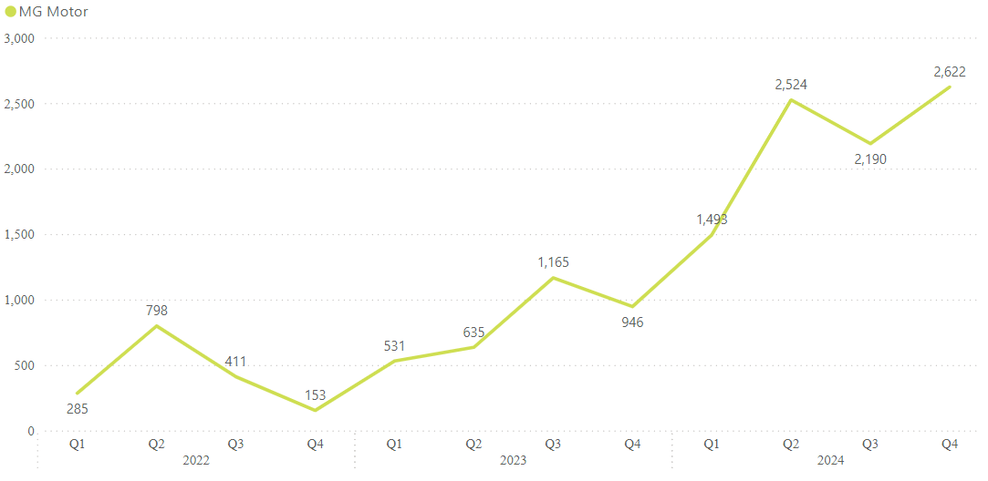
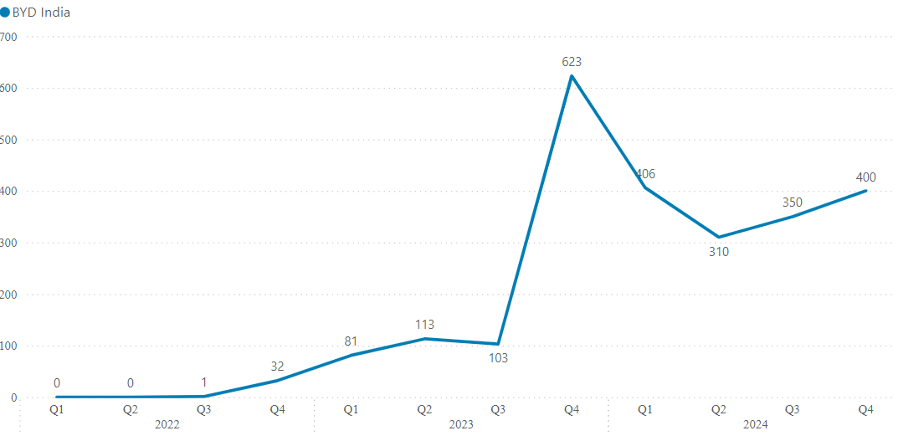
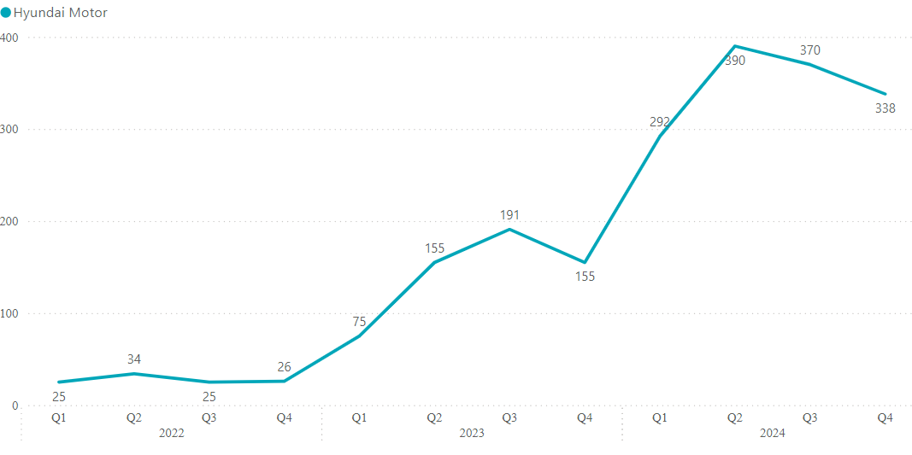
MG Motors experienced fluctuations in sales volume, with a total of 3,277 units sold in FY 2023. By FY 2024, the sales volume had increased significantly to 8,829 units, representing a year-on-year growth of approximately 169.4%
BYD India started with no sales in the first two quarters of FY 2022 but then saw a gradual increase in sales. By Q4 of FY 2023, they had sold 623 units. After that there was a decline in sales volume. BYD India ended FY 2023 with a total of 920 units sold and in FY 2024 selling a total of 1,466 units, reflecting a year-on-year growth of 59.3% .
Hyundai Motor had minimal sales in both FY 2022 and FY 2023. However, in FY 2024, the company saw a significant increase in sales volume, nearly doubling its sales compared to FY 2023.

Slide 11
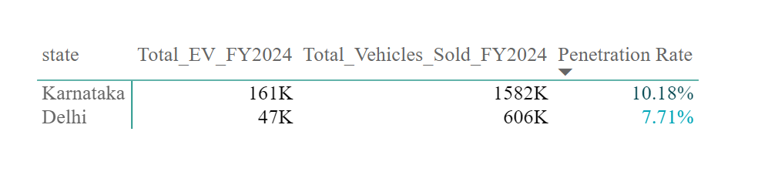
Karnataka's total vehicle sales volume are approximately 2.61 times greater than those in Delhi.
The number of EVs sold in FY 2024 in Karnataka (160,989) is approximately 26.56% of the total vehicles sold in Delhi (606,348).
Karnataka sold over three times the number of EVs compared to Delhi in FY 2024.

Slide 12
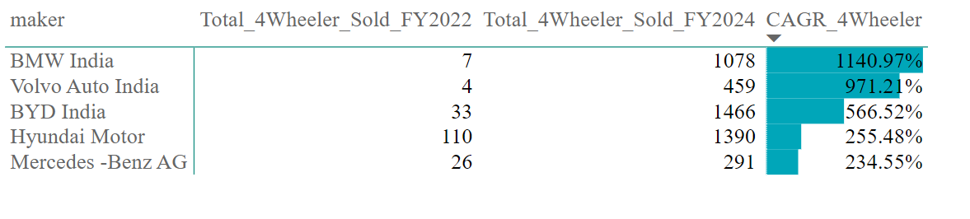
CAGR in 4-Wheeler Units for Top 5 Makers from FY 2022 to FY 2024
These figures clearly show how these makers are scaling up in the EV market.

Slide 13
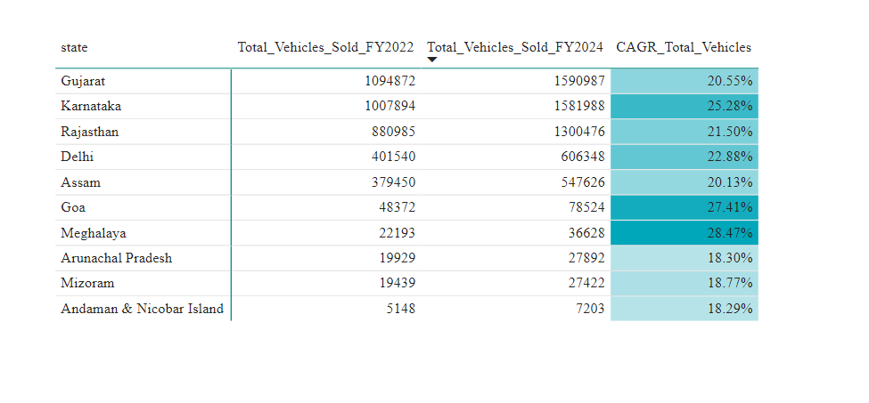
Top 10 States with the Highest CAGR in Total Vehicle Sales from FY 2022 to FY 2024
Although Gujarat and Karnataka recorded the highest total vehicle sales in both FY 2022 and FY 2024, Goa and Meghalaya experienced the highest Compound Annual Growth Rates (CAGR), with 27.41% and 28.47% respectively.

Slide 14
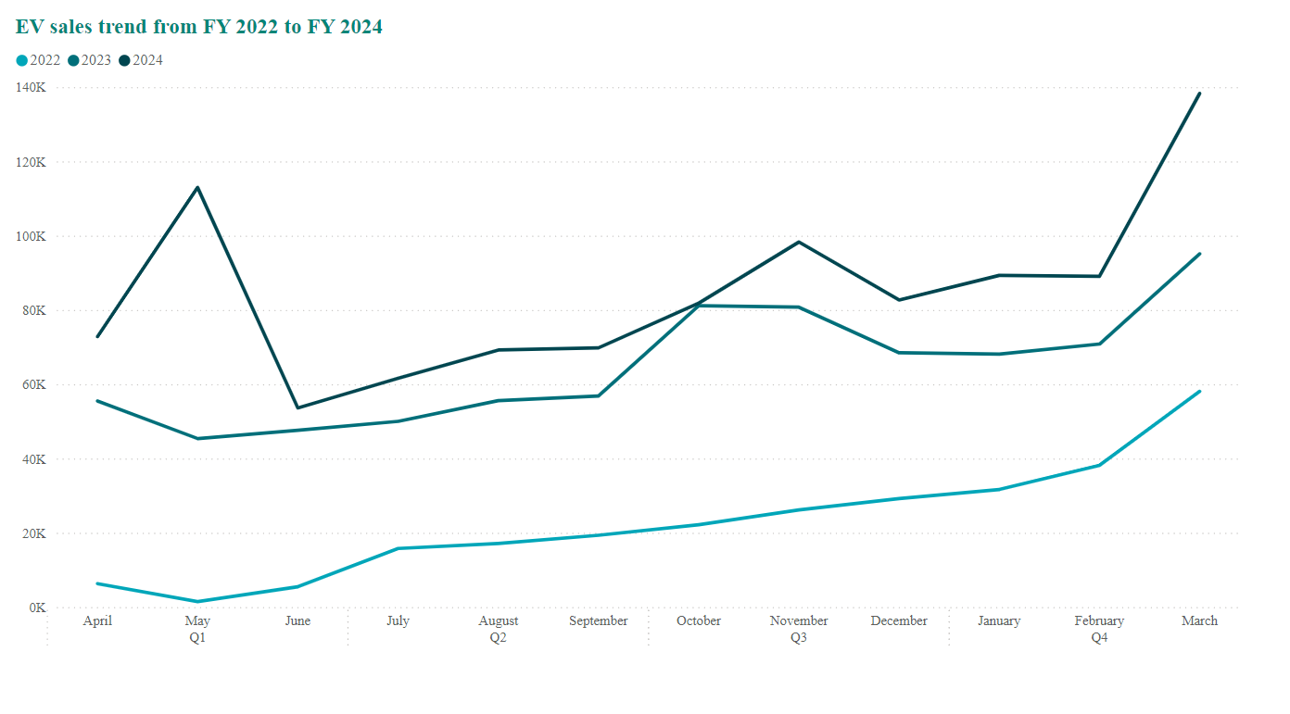
The months like Oct, Nov and Dec generally sees a surge in EV sales likely due to factors like holiday season promotions.
The reason for surge in March is due to the rush to buy before the end of the FAME subsidy scheme in respective fiscal years.

Slide 15
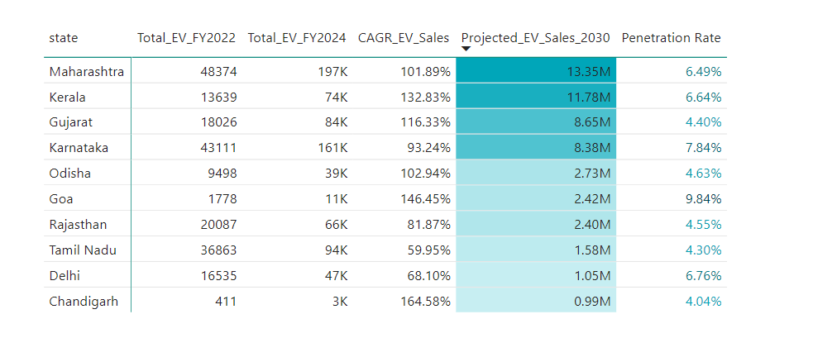
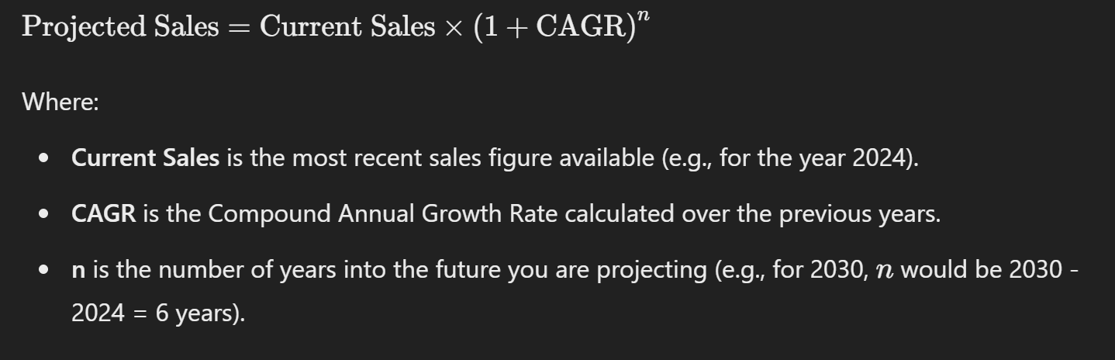
Projected EV (Both 2 & 4 wheelers) Sales for Top 10 States by Penetration Rate in 2030: Forecast Based on Historical CAGR Trends
Formula used to calculate Projected EV sales

Slide 16
Revenue growth rate of 4-wheeler and 2-wheelers EVs in India for fiscal years 2022 vs 2024 and 2023 vs 2024
Category | FY 2022 vs FY 2024 | FY 2023 vs FY 2024
2-Wheelers | 269.28% | 28.13%
4-Wheelers | 367.79% | 83.08%
This indicates that EV market is expanding.

Slide 17
What motivates Indian customers to purchase EVs?

Slide 18
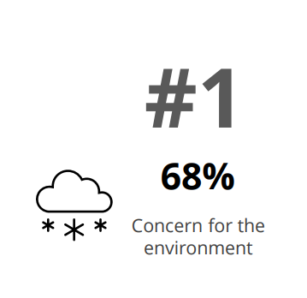
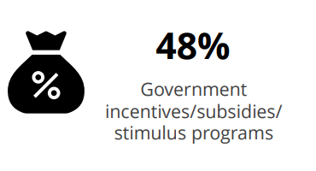
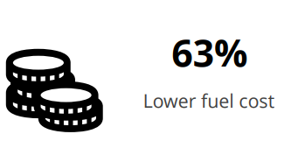
The primary reasons for customers choosing (EVs) in India includes:
This data is taken from https://www2.deloitte.com/content/dam/Deloitte/in/Documents/consumer-business/in-consumer-business-deloitte-gacs-report-2024-india-noexp.pdf

Slide 19
How did Indian government incentives drive the growth in EV adoption?

Slide 20



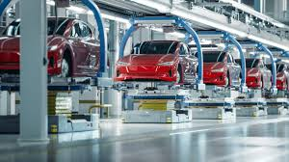

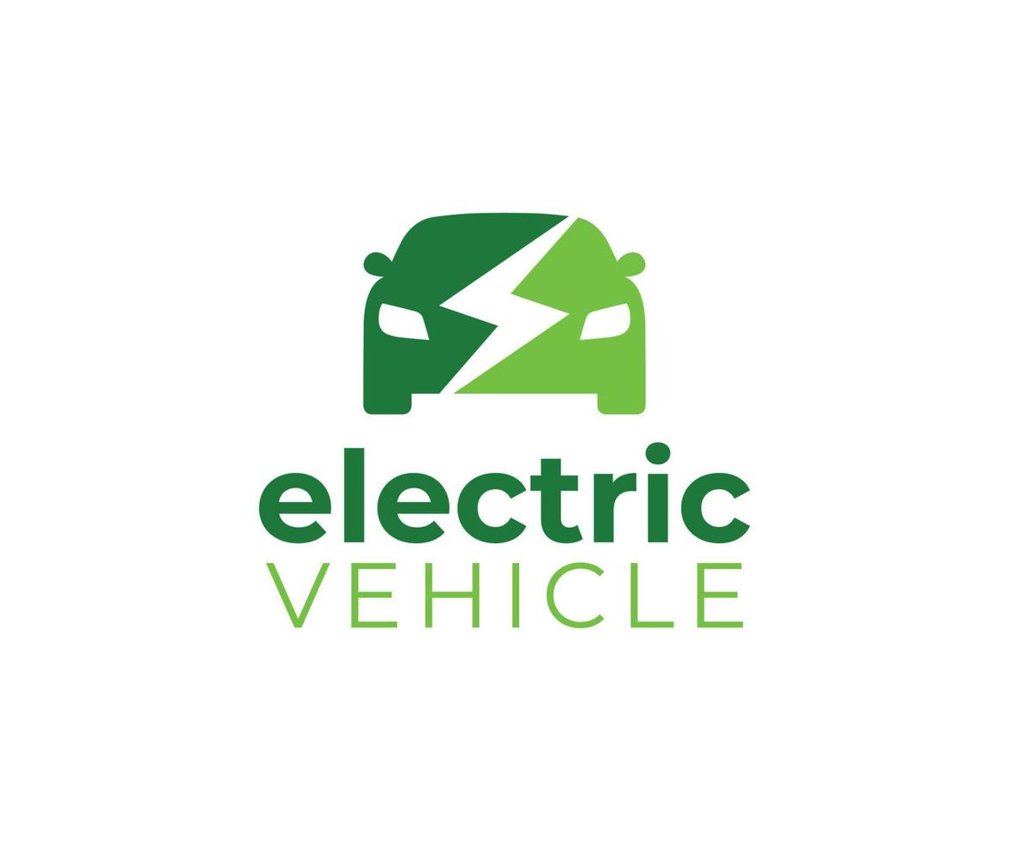
Government incentives and subsidies have played a significant role in boosting the adoption of both 2-wheelers and 4-wheelers in India, particularly electric vehicles (EVs).
Driven by a shift in global climate policies, central and state governments have introduced initiatives such as the Faster Adoption and Manufacturing of Electric Vehicles (FAME) scheme to speed up the adoption of EVs.
Decrease in cost
Cost decreases
Giving people subsidies like
Exemptions in income tax
Making loans easier
GST 5% on EVs compared to 48% ICE vehicle
Will not tax the EV Companies
Give discount on land costs, import duties
Demand Increases
Production
Increases

Slide 21
Have Indian states leveraged government subsidies to boost growth in the EV market?

Slide 22
This table summarizes the incentives and subsidies provided by different Indian states for electric vehicles, making it easier to compare and evaluate the best options for setting up an EV manufacturing unit or purchasing EVs.
State | Subsidy for 2 wheelers | Subsidy for 3-Wheelers | Subsidy for 4-Wheelers | Additional Benefits
Gujarat | Up to ₹20,000 | Up to ₹50,000 | Up to ₹1.5 lakh | No registration charges for EVs.
Maharashtra | Up to ₹25,000 | Up to ₹30,000 | Up to ₹2.5 lakh | No registration charges and road taxes.
Meghalaya | Up to ₹20,000 | No information | Up to ₹60,000 | No registration charges and road taxes.
Karnataka | No direct subsidies for buyers | No direct subsidies for buyers | No direct subsidies for buyers | Concessions for EV makers, battery, and component manufacturers.
Andhra Pradesh | No direct subsidies for buyers | No direct subsidies for buyers | No direct subsidies for buyers | Exemption from road tax and registration charges.
Telangana | No direct subsidies for buyers | No direct subsidies for buyers | No direct subsidies for buyers | Full exemption from registration charges and road tax.
Tamil Nadu | No direct subsidies for buyers | No direct subsidies for buyers | No direct subsidies for buyers | 100% road tax waiver and no registration charges.
Information Source :- https://www.tataaig.com/knowledge-center/car-insurance/subsidy-for-electric-vehicles

Slide 23
Is there a correlation between the number of charging stations and the growth in EV adoption?

Slide 24
A look at what’s driving EV adoption in these five states
State | Total EVs Sold in FY24 | Number of Charging Stations (as of May 2024)
Uttar Pradesh | 305,355 | 583 (3.57% of nationwide total)
Maharashtra | 212,352 | 3,083 (19% of nationwide total)
Karnataka | 169,826 | 5,130 (31.38% of nationwide total)
Tamil Nadu | 101,204 | 643 (4% of nationwide total)
Rajasthan | 98,351 | 500 (3% of nationwide total)
UP having the poor charging infrastructure leads in EV sales, primarily due to the popularity of E3Ws, which typically use simple charging plugs. The state is also home to several E3W makers, which is another reason behind their soaring sales.
States like Maharashtra, Karnataka and Tamil Nadu boasted the sales of electric cars, primarily due to the extensive presence of robust public charging network in the state.
Rajasthan having the lowest number of charging stations (500) among these states, but has decent EV sales (98,351), which indicates other factors might be influencing EV adoption more than charging infrastructure.
Information Source:- https://pressinsider.com/technology/top-five-states-switching-to-electric-vehicles-in-india/

Slide 25
Which state of India is ideal to start the manufacturing unit?

Slide 26
Top-Selling EVs Are Primarily Manufactured in Gujarat, Tamil Nadu, Telangana, and Karnataka—Making These States Ideal for New Manufacturing Units
Existing EV Production Capacity in India
Company Name | Location of factory/manufacturing facility
Ather Energy Private Limited | Karnataka & Tamil Nadu
Hyundai Motor India Ltd | Tamil Nadu & Maharashtra (starting from 2025)
Mahindra & Mahindra Limited | Maharashtra & Telangana
MG Motor India Private Limited | Gujarat
Tata Motors Ltd | Gujarat
TVS Motor | Tamil Nadu
The presence of EV manufacturing units in Maharashtra, Gujarat, Karnataka, and Tamil Nadu can be attributed to several strategic factors:
Government Incentives and Subsidies
Established Industrial Ecosystems
Proximity to Ports and Logistics Hubs
Stable Governance
Strong Demand for EVs
Information Source:-https://www.india-briefing.com/news/indias-prospects-as-an-ev-hub-consumer-market-and-production-capacity-30157.html/

Slide 27
Top 3 Recommendations that can solve the problem of Indian customers

Slide 28
1. Providing enough brands and model in the EV(4-wheelers) sector that meets the customer preferences

Slide 29
CURRENT MARKET IN INDIA
WHAT CUSTOMERS WANT?
As of 2024, the Indian EV market has seen significant growth, with the total number of available models increasing from 15 in 2021 to 32. The majority of these models feature higher battery capacities, with 17 models in the 57.3 to 97.3 kWh range and 10 models in the 17.3 to 57.3 kWh range. However, the under INR 25 lakh segment remains limited, offering only nine EV models with battery capacities under 120 kWh. Additionally, within this segment, only six models provide a range of 230 to 380 kilometers.
According to a survey conducted by Deloitte, 80% of potential EV buyers in India are inclined to spend less than INR 25 lakh on their next vehicle. Additionally, 50% of the surveyed consumers expect an EV range between 200 to 400 kilometers, which they consider essential for making the switch to electric vehicles.
Recommendations: Atliq Motors should focus on expanding affordable EV options under INR 25 lakhs, ensuring they meet the 200 to 400 km range expectation.
Information Source:- https://www.vasudha-foundation.org/examining-the-electric-four-wheeler-market-in-india/

Slide 30
2.Expanding Existing Charging Infrastructure

Slide 31
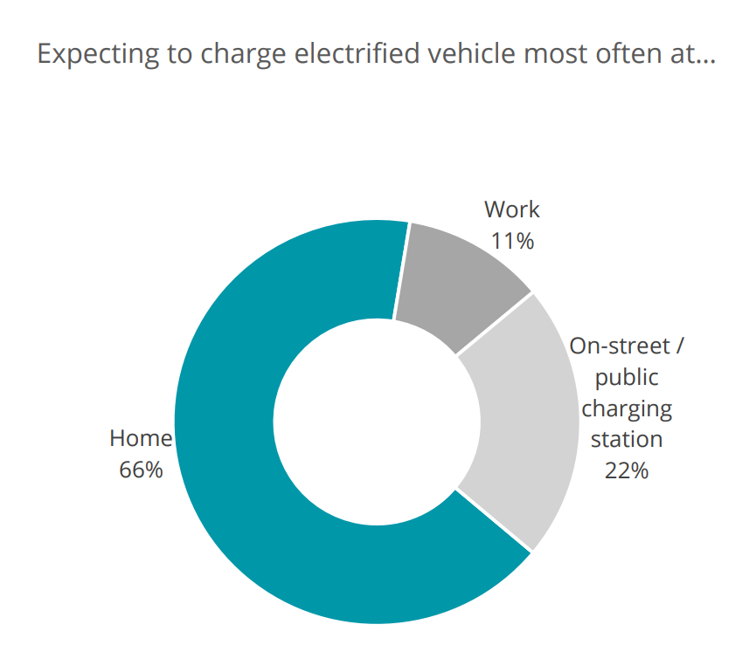
As per The Times of India dated on 28th July 2024
One of the central concerns highlighted by the survey was charging anxiety, affecting 88% of e-car owners. This issue has surpassed range anxiety, which had traditionally been a significant concern. Despite the presence of more than 20,000 EV charging stations across India, respondents voiced their frustration over the opaque visibility and accessibility of these stations. They emphasized that finding a safe and functional charging station remains a considerable challenge, even as most drivers restrict their intercity journeys to less than 50 kilometers.
Deloitte Findings
Recommendations:- Investing in both public and home charging is critical for further EV adoption.

Slide 32
3. Building a Robust Service Network

Slide 33
As per The Economic Times dated on 28th July 2024,
According to the respondents, their electric vehicles often felt like "a black box" that was difficult to understand. Compounding this issue was the inability of local mechanics to solve minor problems. Many e-car owners also expressed frustration over not being able to obtain a clear picture of repair costs due to the lack of multiple repair shop options.
AtliQ Motors can address this concerns of electric vehicle (EV) owners by implementing several strategies
Test Drive Experience
Providing User Manuals
Training programs for local mechanics
Authorized service center to offer transparent pricing and repair options

Slide 34
THANK YOU

